Slide 1
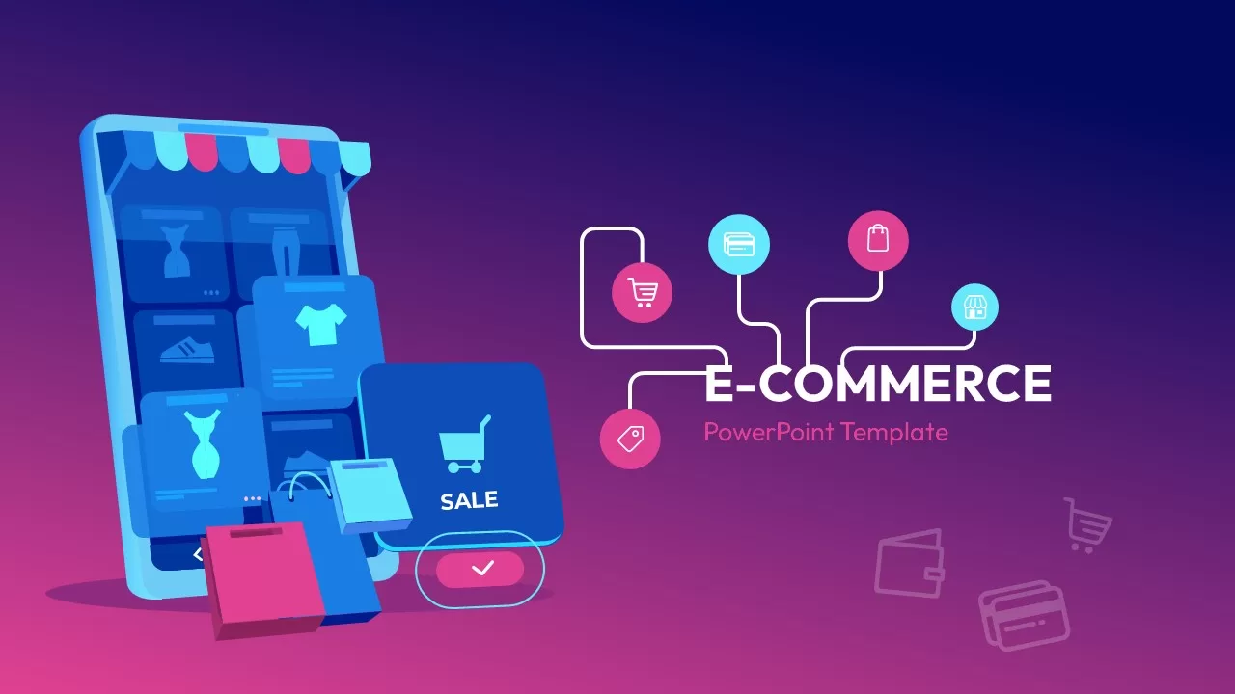
MySQL Queries on E-Commerce platform
BY G.Sumanth

Slide 2
Introduction
An E-Commerce Website Project is an online platform that manages products, customer accounts, shopping carts, and orders. From a DBMS (Database Management System) perspective, this project focuses on organizing, storing, and retrieving large amounts of dynamic data efficiently. It ensures data consistency, security, and quick transaction processing between buyers and sellers.

Slide 3
PROBLEM STATEMENTS
The following are the core problem statements for an e-commerce DBMS, categorized by key business and technical requirements:
Core E-Commerce DBMS Problem Statements:
Customer Data Management: Tracking fragmented buyer information and multiple delivery addresses.
Product Cataloging: Organizing a massive inventory of varying brands, categories, and dynamic pricing.
Inventory Tracking: Updating stock levels automatically to prevent over-selling and out-of-stock issues.
Shopping Cart & Checkout: Managing transient cart data securely before order finalization.
Data Retrieval: Enabling fast product search and filtering for a large database of items.
Reporting & Analytics: Generating sales summaries and tracking best-selling products

Slide 4
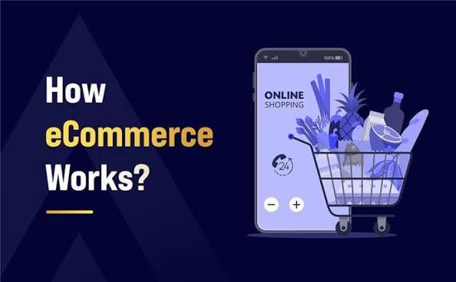
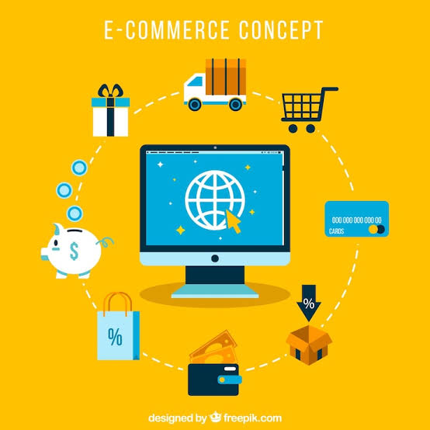
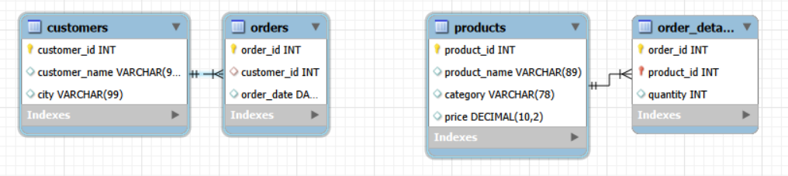
MAIN ENTIES(TABLES)
CUSTOMERS Customer_id, Customer_name, City
PRODUCTS Product_id, Product_name, Category, Price
Orders Order_id, Customer_id, Order_date
Order_details Order_id, Product_id, Quantity

Slide 5
Tables Creation
Customers
CREATE TABLE Customers (
customer_id INT PRIMARY KEY,
customer_name VARCHAR(50),
city VARCHAR(50)
);
PRODUCTS
CREATE TABLE Products (
product_id INT PRIMARY KEY,
product_name VARCHAR(50),
category VARCHAR(50),
price DECIMAL(10,2)
);
Orders
CREATE TABLE Orders (
order_id INT PRIMARY KEY,
customer_id INT,order_date DATE,
FOREIGN KEY (customer_id)
REFERENCES Customers(customer_id)
);
Order_Details
CREATE TABLE Order_Details (
order_id INT,product_id INT,
quantity INT,PRIMARY KEY(order_id, product_id),
FOREIGN KEY(order_id) REFERENCES Orders(order_id),
FOREIGN KEY(product_id) REFERENCES Products(product_id));

Slide 6
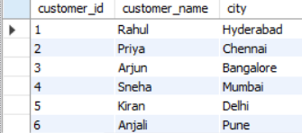
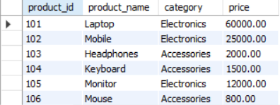
Scenarios
Query for listing all the Customers & Products
SELECT * FROM Customers;
SELECT * FROM Products;

Slide 7
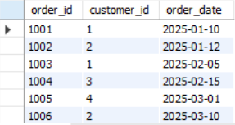
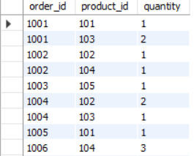
Query to list all Orders and their details?
SELECT * FROM Orders;
SELECT * FROM Orders_Details;

Slide 8
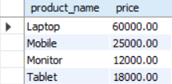
Queries(Basic SELECT)
1.Display all products with price greater than 10000.
SELECT product_name, price FROM products WHERE price>10000;

Slide 9

2.List all orders placed in February 2025.
SELECT * FROM orders WHERE order_date BETWEEN '2025-02-01' AND '2025-02-28';

Slide 10
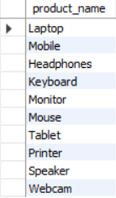
3.Display unique product names.
SELECT DISTINCT product_name FROM products;

Slide 11

QUERIES(Aggregate Functions)
4.Find the total number of customers.
SELECT COUNT(*) AS "Total_Customers" FROM customers;

Slide 12

5.Find the average product price.
AGGREGATE FUNCTIONS
SELECT ROUND(AVG(price),2) AS "AVERAGE_PRICE" FROM products;

Slide 13

6.Find the most expensive product.
SELECT product_name AS "Name",MAX(price) AS "Expensive_Product" FROM products group by product_name LIMIT 1;

Slide 14

7.Count products in each category.
SELECT category,COUNT(category) as "Total_Categories" From PRODUCTS group by Category;

Slide 15
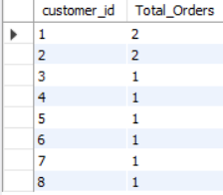
8.Count orders placed by each customer.
SELECT customer_id,count(order_id) as "Total_Orders" from orders group by customer_id;

Slide 16
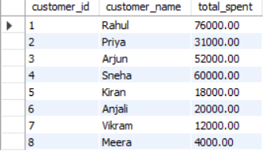
Joins
9.Find total amount spent by each customer.
SELECT c.customer_id,c.customer_name,SUM(p.price * od.quantity) AS total_spent FROM Customers c JOIN Orders o ON c.customer_id = o.customer_id JOIN Order_Details od ON o.order_id = od.order_id JOIN Products p ON od.product_id = p.product_id GROUP BY c.customer_id, c.customer_name;

Slide 17

10.Find total sales quantity by category.
SELECT P.category,sum(O.quantity) as Total_Quantity from products P join order_details O on P.product_id=O.product_id group by category;

Slide 18

11.Show customers who placed more than 1 order.
SELECT C.customer_id,C.customer_name,count(*) as "Total_Orders" from Customers C leftf join Orders O on C.customer_id=O.customer_id group by C.customer_id having count(*)>1;

Slide 19
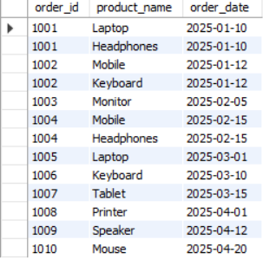
12. Display order details with product names.
SELECT OD.order_id,P.product_name,O.order_date FROM products P join Order_details OD on P.product_id=OD.product_id right join Orders O on O.order_id=OD.order_id;

Slide 20
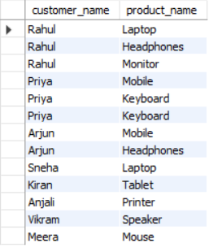
13. Show customer names and products they purchased.
SELECT C.customer_name,P.product_name from Customers C join Orders O ON C.customer_id=O.customer_id join order_details OD ON O.order_id=OD.order_id join Products P on P.product_id=OD.product_id;

Slide 21

14.Find products priced above the average price.
SUBQueries
SELECT product_id, product_name from products where price>(select avg(price) from products);

Slide 22

15.Find customers who purchased the most expensive product.
SELECT DISTINCT c.customer_name, p.product_name FROM Customers c JOIN Orders o ON c.customer_id = o.customer_id JOIN Order_Details od ON o.order_id = od.order_id JOIN Products p ON od.product_id = p.product_id WHERE od.product_id =
(SELECT product_id FROM Products WHERE price = (SELECT MAX(price) FROM Products));

Slide 23
E-Commerce Sales Analysis – Key Findings & Conclusion
1. Total Revenue Generated
Total Revenue: ₹2,73,500
The business generated significant revenue from product sales across multiple categories.
2. Top Spending Customers
Customer | Amount Spent
Rahul | ₹76,000
Sneha | ₹60,000
Arjun | ₹52,000
Insight: These customers contribute the highest share of revenue and should be targeted for loyalty programs.

Slide 24
3. Best-Selling Products (By Quantity)
Product | Units Sold
Mouse | 5
Speaker | 4
Keyboard | 4
Insight: These products have strong customer demand and should be prioritized for inventory management.
4. Inactive Customers
Customer
Rohan
Neha
Insight: These customers have not placed any orders and represent opportunities for targeted marketing campaigns.

Slide 25
5. Unsold Products
Product
Webcam
Insight: The product may require promotional offers or inventory review.
Final Conclusion
Conclusion
Electronics products are the primary source of revenue.
Rahul, Sneha, and Arjun are the most valuable customers.
Laptop and Mobile generate the highest revenue.
Mouse, Speaker, and Keyboard are the most frequently purchased products.
Some customers remain inactive, indicating opportunities for customer engagement.
Unsold products should be reviewed to improve inventory efficiency.
Business Recommendation
Focus marketing efforts on top-performing products and loyal customers.
Introduce promotional campaigns for inactive customers and unsold products.
Maintain sufficient inventory for high-demand products to prevent stock shortages.

Slide 26


